Slide 1

Not promoted?
Consider appealing
Monia FANCIULLETTI
12 June 2025

Slide 2

We record the presentation part of this conference.
We do NOT record the Q&A part; and we don’t publish the chat.
The recordings and this presentation will be available after this conference on our website.

Slide 3


Overview of the appraisal and promotion/reclassification exercise
Staff representatives play a crucial role to ensure the “comparison of merits” which is required by the Staff Regulations
However: final decision is with DG!
JANUARY
FEBRUARY
MARCH
Self-assessment
Appraisal interview
Appraisal report
MARCH
DG HR is allocating promotion quotas to each DG per grade
APRIL
MAY
DG draft promotion proposals lists
Discussion with staff representation
Promotion proposal lists published
Joint Promotion Committee
Publication of promotions list
Promotion /reclassification
exercise
May be appealed in Sysper2
May be appealed using Art. 90.2 (Complaint)

Slide 4
Average promotion pace
Grade | Assistants | years | Administrators | years | Assistants/Clerks | years
13 | — |  | 15% | 6,5
12 | — |  | 15% | 6,5
11 | — |  | 25% | 4
10 | 20% | 5 | 25% | 4
9 | 8% | 12,5 | 25% | 4
8 | 25% | 4 | 33% | 3
7 | 25% | 4 | 36% | 2,8
6 | 25% | 4 | 36% | 2,8 | —
5 | 25% | 4 | 36% | 2,8 | 12% | 8,3
4 | 33% | 3 | — |  | 15% | 6,5
3 | 33% | 3 | — |  | 17% | 5,8
2 | 33% | 3 | — |  | 20% | 5
1 | 33% | 3 | — |  | 25% | 4
These are collective, not individual guarantees!
Data from the Staff Regulations
Notes:
The function group is not clear from the judgement, but according to paragraph 8 of the judgement in F‑126/15, the plaintiffs were hired as CA with unlimited contracts.
https://curia.europa.eu/juris/document/document.jsf?text=&docid=181862&pageIndex=0&doclang=FR&mode=lst&dir=&occ=first&part=1&cid=1611663#point8
Curia being an Institution, this means Article 3a of the CEOS ➔ manual or administrative support service tasks ➔ (Art. 80 CEOS): GFI

Slide 5
Average reclassification pace
FG | Grade | bracket | Average
IV | 17 | [6, 10] | 8
 | 16 | [5, 7] | 6
 | 15 | [4, 6] | 5
 | 14 | [3, 5] | 4
 | 13 | [3, 5] | 3
III | 11 | [6, 10] | 8
 | 10 | [5, 7] | 6
 | 9 | [4, 6] | 5
 | 8 | [3, 5] | 3
II | 6 | [6, 10] | 8
 | 5 | [5, 7] | 6
 | 4 | [3, 5] | 3
I | 2 | [6, 10] | 8
 | 1 | [3, 5] | 3
These are collective, not individual guarantees!
Data from the GIPs
5
Notes:
Table with retirement ages: Annex XIII, art. 22
https://myintracomm.ec.europa.eu/hr_admin/en/staff-regulations/annexes/Pages/annex-13.aspx#021
Automatic/max age of 65: Annex XIII, art. 23
https://myintracomm.ec.europa.eu/hr_admin/en/staff-regulations/annexes/Pages/annex-13.aspx#022

Slide 6
Reference dates
Seniority in the grade: the reference date for promotion is 1 January of the given year
At least 2 years in the grade for a promotion/reclassification
If you change DG: the cutting date for the responsibility for your promotion is 2 March

Slide 7
June
The draft list of proposed officials for promotion has been published today 12 June
As well as the draft list of proposed CAs for reclassification
You have 5 working days to file an appeal
Days where you could not access Sysper do not count in the 5 working days (sick/annual leave, bank holidays, …)
Button not visible ➔ write to HR

Slide 8

Appeal
Negative consequences?
Only the members of the Joint Promotion/Reclassification Committee will decide on your appeal and promotion/reclassification – your HoU, your Director are not involved anymore in this and cannot see your appeal!
If you get a promotion/reclassification via an appeal ➔ one problem less for them next year

Slide 9
APPEAL DOS AND DON’TS
The promotion committee will analyse your appeal on the basis on these 3 elements:
  Merits, Responsibilities (management and team leadership; financial, representation), Languages (used at work)
  Draft max. one A4 page:
  Add quotations from your reports underlining your performance (the most positive adjectives)
  Mention mobility or secondment (e.g. interest of service)
  NEVER refer to others, NEVER compare your performance with other colleagues’ performance
  Keep the text as short as possible but precise and concise!
  Don’t repeat your appraisal reports!
Notes:
Act of having an adverse effect

Slide 10
EXAMPLE
Quotations from my report 2023
contributed significantly to the performance of the unit
contributions were instrumental in drafting the adopted strategies and .. acts
demonstrated excellent command of the political and legal aspects of the XX portfolio
demonstrated that she is an excellent team player
demonstrated very good negotiation skills
Quotations from my report 2022
deliver work of high-quality standard…instrumental in getting the unit off to a flying start
excellent command of the legal aspects
fulfilled all the responsibilities of a very good manager in the Commission
has the right political sensitivities and maturity to take on higher responsibilities in the future
I have always been able to count with XX’s support, competence and dedication
We have put together not only a highly efficient but also very pleasant team and working atmosphere.

Slide 11
WHAT CAN G2004 DO FOR YOU?
We can help you by reviewing your draft appeal ➔ register on our website.
We cannot write the draft for you!
Please draft it over the weekend at the latest!
  We need time for the review
  You need time to incorporate the feedback
Deadline in Sysper: 19 June
This is a hard deadline.

Slide 12
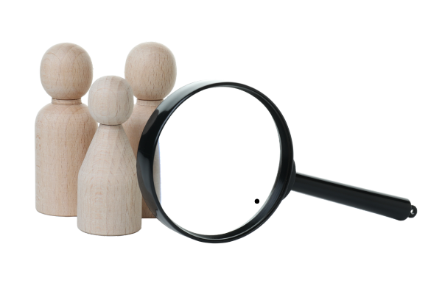
July – August
The Joint Promotion Committee starts its work
You may or may not see their accesses to your file in Sysper (they get PDF versions from HR, but sometimes they need more than the reports)
The members of the Joint Promotion Committee analyse and compare the appeals and the appraisal reports since your last promotion

Slide 13

September
The members of the Joint Promotion Committee:
  Discuss each and every appeal
  Come to an agreement on each case whether to propose or not for promotion
  Proposes the final draft list for promotion to DG HR
  The Committee has 5% of the total promotion quota at its disposal

Slide 14
October
The members of the Joint Promotion Committee hold a meeting with DG HR to approve the final list
The Appointing Authority (DG HR) has the final word before publishing the final list of promoted officials
Reasons for exclusion from the promotion exercise: CCP, IDOC

Slide 15
November
Mid November: the final list of promoted officials is published
Your promotion will take effect retroactively as of 1 January of the given year
Your promotion will be visible in your December salary slip
EXERCISE FINISHED
You can make an article 90.2 complaint against non-promotion (very low chances!)

Slide 16


QUESTIONS?
GET IN
TOUCH
WITH US
Write - Join
+32 229 98850
Internet - Facebook - X

