Slide 1
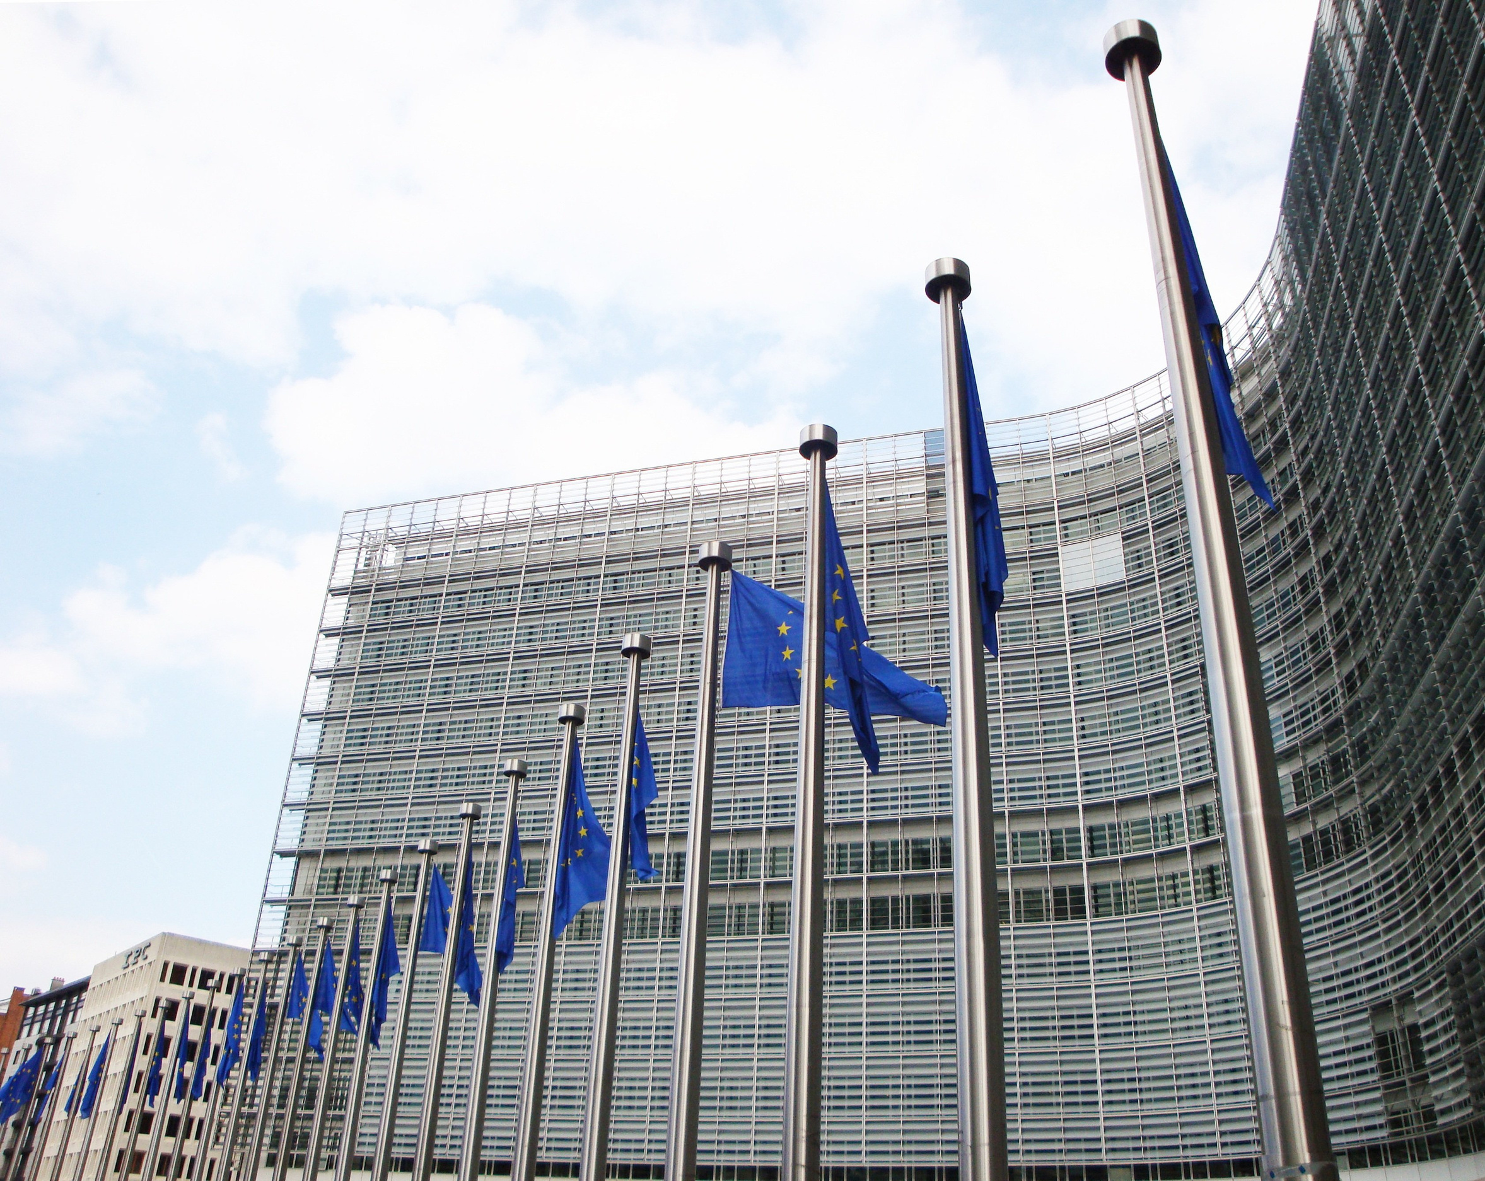


Meeting with members
Updates, exchange of views and Q&A
5 May 2026

Slide 2
Agenda
1. European schools
2. Competitions
3. Social dialogue on sick leave
4. Large Scale Review
5. Additional topics
6. Contract Agents
7. Q&A

Slide 3

European schools
European Schools System in crisis
• Overcrowding, safety incidents
• Exposure to drugs and alcohol
• No harmonisation between Brussels schools
• Lack of accountability and transparency
Mental health
• Issues confirmed by EP June 2022 study
• Pandemic deepened an already competitive system
Notes:
EUROPEAN SCHOOLS — issues & reform demands
• Generation 2004 conference (EEAS section, 25 March 2025) confirmed the same picture across DGs: the European Schools System (ESS) is in crisis and needs urgent, comprehensive reform.
• Key issues raised by members and parents:
– Structural overcrowding and infrastructure shortages.
– Safety concerns: violence, criminal activity on premises, insufficient law-enforcement presence.
– Exposure to drugs and alcohol.
– No harmonisation between Brussels schools — different (sometimes contradictory) rules per site.
– Lack of transparency and accountability.
• Mental health: this echoes the European Parliament's June 2022 study — bullying, drug abuse, lack of human resources, insufficient time from teachers to support pupils. The pandemic worsened an already competitive, academically-driven environment.
• Generation 2004 reform demands:
– More school psychologists in primary and secondary, in real support roles — not administrative.
– Better supervision during breaks and in classrooms.
– Allow children to change class group within the same school.
– Tackle the teacher shortage and reduce class sizes.
– Real role for parents in shaping policies on psychological support and well-being.
– Proper support for pupils with disabilities or special education needs.
– Address structural overcrowding and the physical environment.

Slide 4
Reform demands
Generation 2004 reform demands
• More school psychologists in real support roles
• Better supervision; flexibility to change class within the same school
• Tackle teacher shortage; reduce class sizes
• Real role for parents; proper SEN support
• Address structural overcrowding

Slide 5
Evere
"Temporary school, permanent uncertainty"
• ~1 500 pupils on a temporary urban-planning permit
• Permit expires 16 March 2027
• Site is in PAD Défense planning zone (road + green spaces)
• Buildings Agency aims to file renewal before end-2026
• No news yet — families and staff in limbo
What we're doing
• Evere put on Brussels LSC plenary agenda
• Pushing Commissioner Serafin for a clear commitment
• Working with supportive MEPs (CULT committee)
Notes:
EUROPEAN SCHOOLS — Evere & School trips
EVERE
• ~1 500 pupils of European School II are in Evere on a temporary urban-planning permit.
• Permit expires 16 March 2027. Site is inside Brussels' PAD Défense planning zone (road + public green spaces, not a permanent school).
• The Buildings Agency intends to file a renewal request before end-2026; if accepted, validity would extend to 2037 — administrative prolongation, not a permanent solution.
• Status as of 5 May 2026: no news yet — no application confirmed and no formal commitment from Belgian authorities or the Brussels-Capital Region.
• Coordination between federal government (landowner), Brussels-Capital Region (planning authority) and the Commission (user) has been minimal.
• Woluwe major works in two phases until 2029, all secondary levels relocating from Sept. 2026 — eases pressure but does not replace the need for an Evere decision.
• What we're doing: agenda item at Brussels LSC plenary, pushing Commissioner Serafin for a legally enforceable commitment, encouraging supportive MEPs (CULT committee) to table written questions.
SCHOOL TRIPS
• Framing: "We are not questioning the objective — we fully support school trips. What we are questioning is a system that is more expensive, less transparent, and more burdensome than what existed before."
• Core demands (non-negotiable, immediate):
– Full transparency: publish price breakdown (transport, accommodation, agency fee, margin) and final financial statement after each trip.
– Right to competition: schools must be able to request 2–3 alternative offers, or organise trips independently when justified.
– End the de facto monopoly: multi-supplier framework or reopening competition per trip.
– Parental financial protection: clear cancellation/compensation rules, mandatory travel insurance, refund mechanisms.
• Strong structural demands:
– Cap on agency fees (e.g. 5–7 % or fixed fee). Anchor: today ~12.5 %.
– Price-benchmarking obligation per trip.
– Restore teacher autonomy on accommodation, logistics and pedagogical content.
– Minimum service standards (accommodation, food, safety, distance/time limits for young children).
• Fairness & access: cost ceilings, support for families in difficulty; real parental involvement (co-decision, not just consultation).
• Governance: independent review of the system; one-year pilot of an alternative model with direct booking and multi-offer.
• Closing position: "At this stage, we are not asking for a full reform overnight. But we need immediate corrective measures: transparency, competition, and accountability. Without these, the system will continue to lose trust."

Slide 6
School trips
Fix a system that is not delivering
• Full transparency: publish price breakdown and final accounts
• End de facto monopoly: 2–3 alternative offers / multi-supplier
• Cap agency fees (~5–7 %); evidence today is ~12.5 %
• Parental protection: cancellation, mandatory insurance, refunds
• Restore teacher autonomy on accommodation, logistics, pedagogy
• Independent review; one-year pilot of an alternative model
Notes:
COMPETITIONS — talking points
• Headline: the system is in transition but not yet stable — both internal and external competitions are under pressure.
• Internal competitions:
– Latest planning was updated in December, but there is still no clear timeline for the remaining competitions.
– Colleagues are left in the dark and cannot plan their careers.
– Move toward inclusiveness is partial: AST/SC colleagues still do not have access to AD competitions.
• AD7 internal competition — a real breakthrough:
– First time in nearly 20 years (since COM/INT/EU10/08/AD5 in 2008) that we see broad cross-category access.
– Result of years of Generation 2004 advocacy to break rigid function-group boundaries.
– For colleagues with 15–20 years in the institution, this is, quite simply, the first real opportunity to apply beyond their function group.
– Aligned with European Court of Auditors recommendations on more flexible, inclusive career paths.
– Caveat: contract agents are again excluded — we are pushing for parallel competitions for contract staff in line with the existing framework.
• External competitions — from paralysis to overload:
– After a paralysis linked to system and contractor changes, EPSO is now overwhelmed.
– AD5 Graduate 2026 closed with more than 170 000 applications — far above expectations.
– This is a scale shift: serious doubts about EPSO's ability to deliver competitions reliably, given the technical issues already seen in previous rounds.
• Administrative burden — the system works against candidates:
– Single Candidate Portal forces re-uploading and re-entering of information that already exists in institutional systems (proof of experience, diplomas).
– Predefined categories often don't match real qualifications.
– No integration with Sysper — duplication and unnecessary workload.
– Hard to square with the institution's "simplification" agenda.
• Webinar reminder:
– Generation 2004 + Yasemos Europeos webinar on the AD7 internal competition.
– Friday, 17 April at lunchtime — format, expectations, preparation strategies. Encourage colleagues to join.
• Link to the Large-Scale Review: a reliable, transparent, user-friendly competitions system is a precondition for the Commission's "modern" and "agile" ambitions. We will keep advocating for that.

Slide 7
Competitions
System in transition — not yet stable
• Internal competitions: planning unclear
• Colleagues left in the dark
• AST/SC still cannot access AD competitions
AD7 internal — a real breakthrough
• First broad cross-category access in nearly 20 years
• Result of years of Generation 2004 advocacy
• Contract Agents still excluded — we keep pushing

Slide 8
Competitions (cont.)
External — from paralysis to overload
• AD5 Graduate 2026: 170 000+ applications
• Serious doubts on EPSO's ability to deliver reliably
Administrative burden
• Single Candidate Portal: re-uploading data
• No Sysper integration; hard to call this 'simplification’
Previous webinars
• Webinar with Yasemos Europeos on AD7
• Friday 17 April, lunchtime
Notes:
SOCIAL DIALOGUE ON SICK LEAVE — talking points
• Why now: everything on sick leave flows from Article 59 of the Staff Regulations and from the General Implementing Provisions (GIPs). The current GIPs date from 2004 — over 20 years old. DG HR, Generation 2004 and the other unions have been meeting since November to negotiate the revision.
• The administration's argument: strict rules keep absenteeism low (4 % and falling). Our line: rules must be fair and respectful, not built on a presumption of guilt.
• Key proposed changes — what to flag to members:
– 12 days of sickness without certificate (Art. 59.2):
· The administration's interpretation of "3 days" includes any kind of leave around the absence, so being sick before/after annual leave triggers a certificate requirement.
· We oppose this interpretation — it looks like a presumption of guilt.
– 5-day deadline to send the certificate:
· Beyond day 5, absence is treated as unauthorised unless force majeure.
· First-time cases may be treated more leniently than repeat ones.
– Obligation to undergo a medical examination:
· Colleagues can be visited or called at unusual hours without notice; missing the call/door = unauthorised absence.
· Control doctor can override the personal doctor and order return to work.
– Arbitration / "independent" doctor:
· Doctor is paid by the Commission — independence is debatable.
· New rule: if the arbitration doctor sides with the Commission for a second time within three years, the staff member pays 50 % of arbitration costs. We are pushing back.
– Sick leave outside the place of employment (Art. 60):
· Administration wants requests 10 days before departure — patronising in our view.
· Positive: if you fall ill while already abroad (holiday, telework), you no longer need permission to stay there. This confirms existing practice.
– 24 hours per year for medical appointments:
· New annual allowance for appointments during working hours.
· BUT it replaces the existing 3-day special leave for medical examinations outside the place of employment — whether this is a good trade-off depends on personal situation.
– Medical part-time:
· Was 3 months + 3 in exceptional cases.
· New proposal: up to 6 months over a 4-year rolling period.
· We asked for parallel schemes for different pathologies — admin not enthusiastic.
– Mandatory medical examination after 20 days of sick leave for "at-risk" posts:
· Drivers, bodyguards, lab workers etc.
· Full list of posts has not yet been shared.
• What the administration is NOT willing to do (yet):
– 100 % telework for colleagues whose health prevents regular office presence.
– Right to be accompanied during medical checks (left to the control doctor's discretion — protects the doctor more than the staff member).
• Where we are: negotiations ongoing, no final draft yet. Administration has promised comprehensive FAQs (e.g. covering tele-consultation certificates).
• Generation 2004 line: we will keep pushing back against any new rules that make an already very strict regime even stricter.

Slide 9

Social dialogue on sick leave
Why now
• Art. 59 SR + GIPs from 2004 — over 20 years old
• DG HR + unions negotiating revision since November
Key proposed changes
• 12 days without certificate (Art. 59.2): admin's interpretation = presumption of guilt
• 5-day deadline to send certificate
• Obligation to undergo medical examination
• Arbitration: 50 % cost-sharing if 'independent' doctor sides with admin twice in 3 years
Notes:
LARGE-SCALE REVIEW — talking points
• Position: the CSC welcomes the LSR as a chance to make the Commission more effective, attractive, agile and purpose-driven — but this can be done within the current Staff Regulations, without weakening rights, working conditions or career prospects.
• Core principles we are defending:
– Social dialogue before any significant change affecting staff.
– No savings at the expense of individual job security, working conditions or careers.
– Equal treatment of officials, temporary agents and contract agents.
– Protect institutional memory and expertise — staff is the Commission's greatest asset.
– AI / digital transformation only with robust human oversight (Human-in-the-Loop / Human-on-the-Loop).
– Compliance with Staff Regulations and COM(2017) 632 final.
– Any LSR proposal that cannot be implemented within current Staff Regulations will be outright rejected.
• Quick tour of the workstreams the CSC has fed into:
– WS1 Purpose & Values: social dialogue is itself a value — the Commission should benchmark Member States' best practices. Wellbeing, health and safety must be treated as fundamental, not secondary. A "values test" on every reform measure. Multilingualism encouraged through trainings during working hours.
– WS2 Leadership: managers must be assessed on people-management skills, not just policy expertise. Mandatory leadership training and a passing exam as a precondition for taking and keeping a management role. Regular 360° feedback. First Head-of-Unit appointment should arguably be temporary, confirmed only after a thorough review. Formalise the participatory leadership network. Recognise "technical leadership" as a real career track.
– WS4 Talent Acquisition:
· Evaluate the 2023 EPSO model (with full staff-rep involvement) in the first half of 2027.
· Shorten deadlines, ensure enough verifiers and markers so the process actually moves.
· Boost attractiveness: detailed staff survey on attractiveness, more days of telework outside the place of employment (Art. 11(1) Working Time Decision), replace "exceptional circumstances" by "duly justified reasons" in Art. 11(2).
· Optimise internal talent: more, regular and timely internal competitions for entry grades up to AD6, no disproportionate eligibility requirements; maintain or increase officials' posts.
– WS5 Directorates-General: any reorganisation must be preceded by genuine social dialogue. Flattening structures must not silently load more work onto staff. Mergers must not become de facto staff cuts. New priority structures should rely on existing expertise via redeployment, not exclusively on external recruitment.
– WS6 Collaboration: management must be formally accountable for cross-boundary information sharing. Consolidate the proliferation of parallel tools. Support cross-DG job shadowing and mobility. Recognise collaboration with staff reps as part of the Commission's collaboration culture.
– WS7 Unlocking Resources: any reallocation must follow transparent rules co-developed via social dialogue. Workforce strategy must address all categories. Pool / project-based allocations must include working-condition rules and return rights. Service fees must not create a two-tier system.
• Offices and Agencies (separate CSC contribution):
– Governance from the Commission to its Agencies must be strongly reinforced — declarations have too often stayed rhetorical.
– Parent DGs are too often disengaged; Commission representatives on management boards are too often appointed at too low a level.
– Article 110 SR rules should apply automatically — not be re-negotiated agency by agency.
– Support transforming Executive Agencies into a European Office for programme management — fully integrated into the Commission, including HR rules.
– Mediation, harassment prevention and disciplinary investigations in agencies should be managed centrally by the Commission for independence and equal service.
– More mobility between agencies and institutions; part of agency staff must be permanent officials; regular internal competitions for TAs/CAs to access official positions; clear reclassification and function-group-change procedures.
– Trade union presence and social dialogue must be organised on a regular and professional basis in all decentralised and executive agencies.
• Where we are: the CSC document is an intermediary contribution. We remain available to feed into the workstream leaders' final recommendations.
• Ask to members: keep sending us concrete examples and concerns from your DG / agency — that's what makes our case credible.

Slide 10
Sick leave (cont.)
Key proposed changes (cont.)
• Art. 60 — sick leave outside place of employment: request 10 days before departure
• New: 24h/year for medical appointments (replaces 3-day special leave)
• Medical part-time: up to 6 months over 4 years (rolling)
• Mandatory medical exam after 20 days for at-risk posts
Where the admin still says no
• 100 % telework for colleagues whose health prevents office presence
• Right to be accompanied during medical checks
Generation 2004 line
• No new rules that further restrict an already very strict regime

Slide 11
Large-Scale Review
CSC position
• LSR welcomed — but achievable within current Staff Regulations
• Any proposal needing SR changes will be outright rejected
Core principles
• Social dialogue before any significant change
• No savings at the expense of jobs, conditions or careers
• Equal treatment of officials, TAs and CAs
• AI / digital transformation only with human oversight (HITL / HOTL)
• Protect institutional memory and expertise

Slide 12
LSR — Workstreams & Agencies
Workstreams covered
• WS1 Purpose & Values — wellbeing as fundamental; 'values test' on all reforms
• WS2 Leadership — people-management skills, mandatory training, 360° feedback
• WS4 Talent — evaluate 2023 EPSO model in H1 2027; more telework
• WS5 DGs — genuine consultation; no de facto staff cuts via reorganisation
• WS6 Collaboration — accountability for info-sharing; tool consolidation
• WS7 Resources — transparent reallocation; protect all categories
Offices & Agencies
• Stronger Commission governance; Art. 110 SR rules apply by default
• Support transforming Executive Agencies into a European Office
• Mediation, harassment, disciplinary services centralised

Slide 13
Contract Agents
Generation 2004 supports the petition for contract agents
• Confirmed at the conference on 4 May 2026
• Calling for social dialogue — other trade unions invited to join
Postulates of the petition
• Career paths for CAs to move to TA positions, and better chances to become officials via internal competitions
• More internal competitions — as many as the system can absorb
• Better recognition of internal talent (function-group upgrades where possible) and of experience, both upon recruitment and throughout the career
Next steps
• Renegotiate GIPs on Working Conditions and GIPs on Reclassification (both already requested)
• Amend the 7-year rule (recourse to non-permanent staff)
How to sign the petition
• Email: REP-PERS-COLLECTIF-DES-CONTRACTUELS@ec.europa.eu
• More on Generation 2004 actions: REP-PERS-OSP-GENERATION-2004@ec.europa.eu — or contact Michal Kowalski
Notes:
CONTRACT AGENTS — talking points
• Generation 2004 publicly confirmed support for the petition in favour of contract agents at the conference on 4 May 2026.
• We called for social dialogue and invited other trade unions to join us — this is a collective effort.
• Postulates of the petition (in line with what Generation 2004 has been pushing for years):
– Career paths for CAs to move to Temporary Agent positions, with better chances to become officials via internal competitions.
– More internal competitions — organised as often as the system can absorb, given current limitations.
– Better recognition of internal talent (e.g. function-group upgrades where possible) and of professional experience, both upon recruitment and throughout the career.
• To put the postulates into practice, our next steps are:
– Renegotiate the GIPs on Working Conditions and the GIPs on Reclassification (both already requested by Generation 2004).
– Amend the 7-year rule that limits recourse to non-permanent staff.
• How members can act:
– Sign the petition: write to REP-PERS-COLLECTIF-DES-CONTRACTUELS@ec.europa.eu
– For more on Generation 2004 actions: REP-PERS-OSP-GENERATION-2004@ec.europa.eu or contact Michal Kowalski directly.

Slide 14
Q&A

Slide 15
Thank you for your cooperation
Marcela Válková, Chair, Generation 2004
generation2004.eu
Rue Joseph II, 70, B-1049 Brussels-Belgium
Secretariat: J-70 01/119
Telephone: +32 229-58014, +32 229-60574

